Slide 1
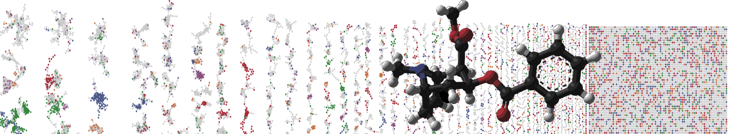


Feature-based molecular networking
Job submission
PRESENTER’S NAME
University of California - San Diego

Slide 2
Materials and Data
Feature-based Molecular Network
https://ccms-ucsd.github.io/GNPSDocumentation/tutorials/featurebasedgnps/
GNPS Feature-Based Molecular Networking Workshop - American Gut subset with metadata for plant consumption
MassIVE dataset MSV000082678.

Slide 3
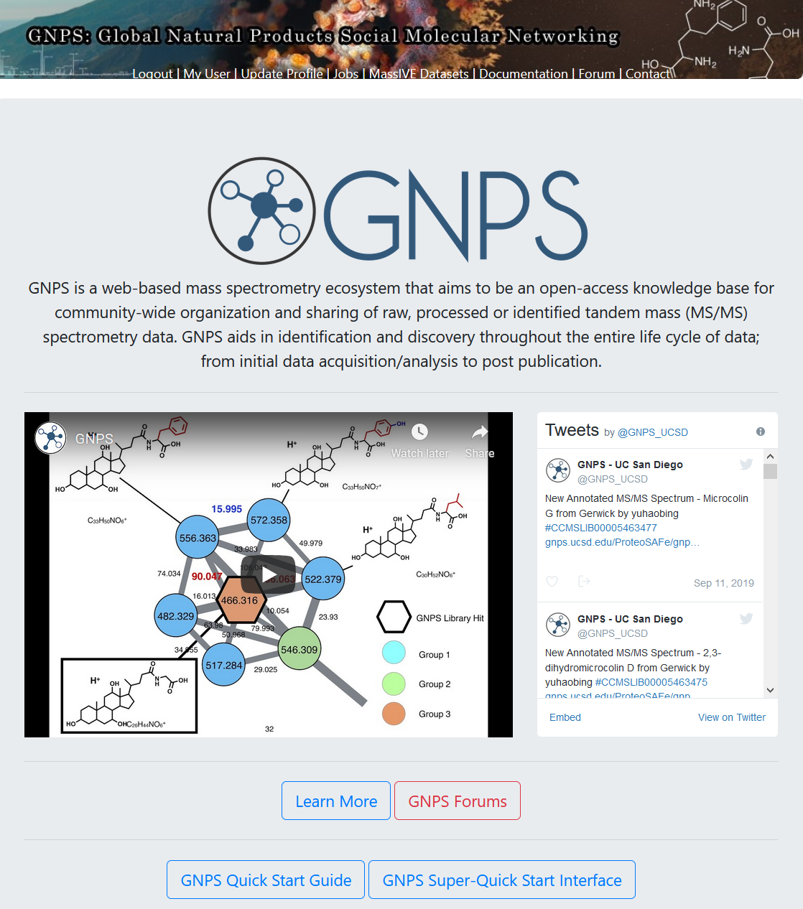

Slide 4
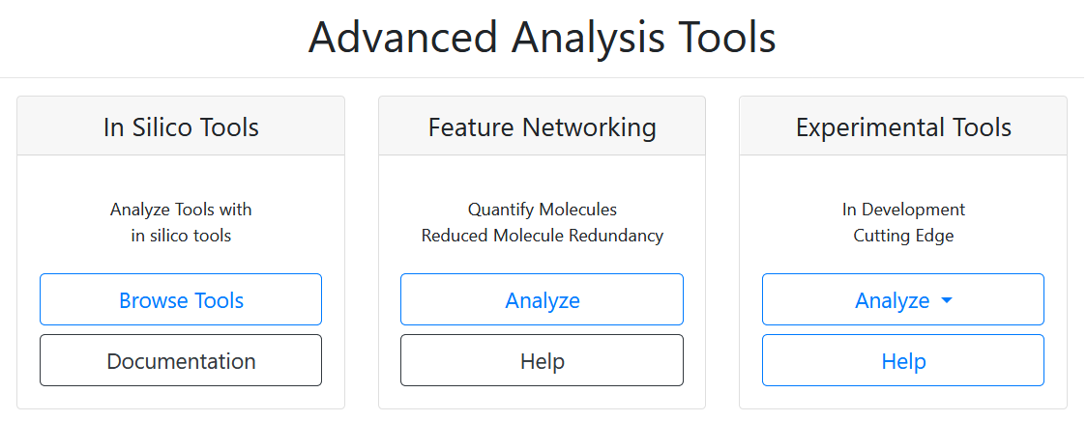

Slide 5
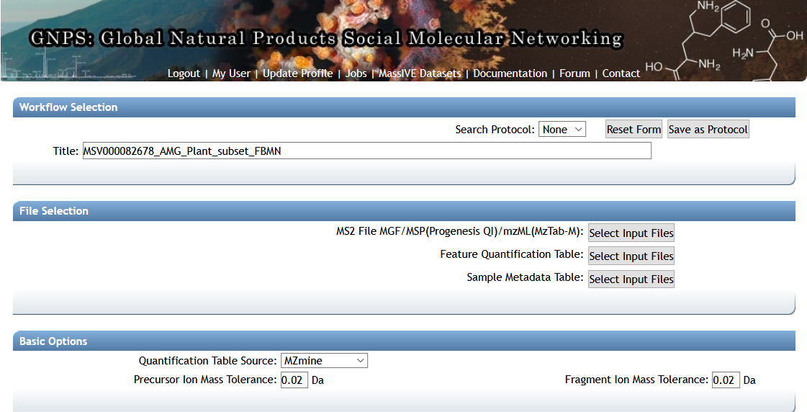

Slide 6
Select input files

Slide 7
Select input files
Click

Slide 8
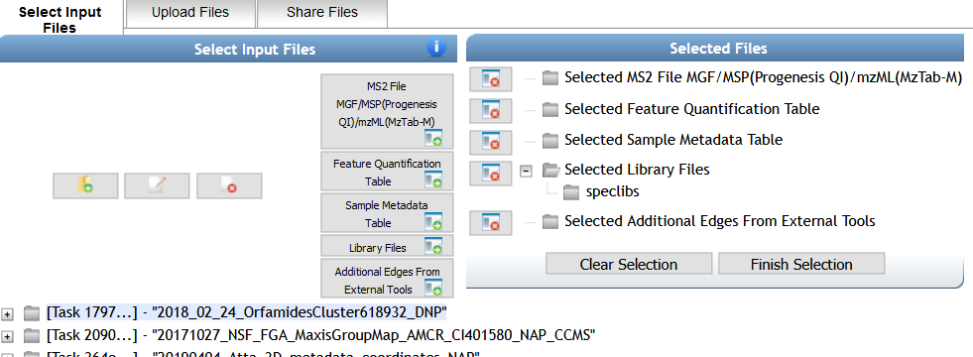
Import the data set
Click

Slide 9
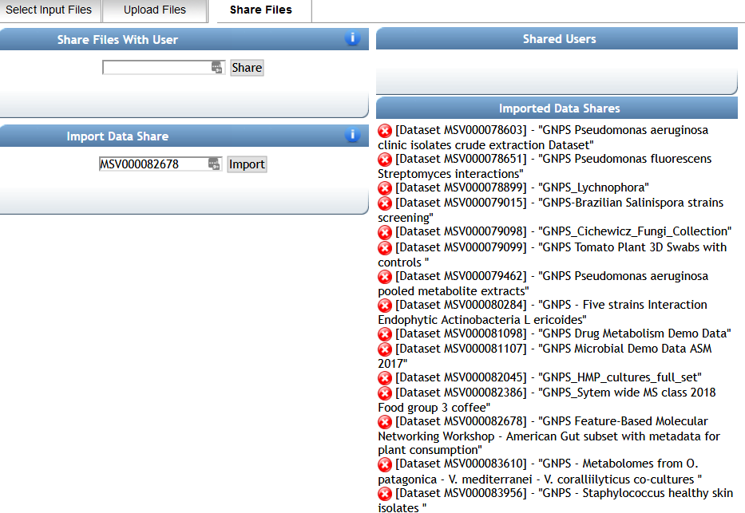
Import the data set
Click
Click
Click
MSV000082678

Slide 10
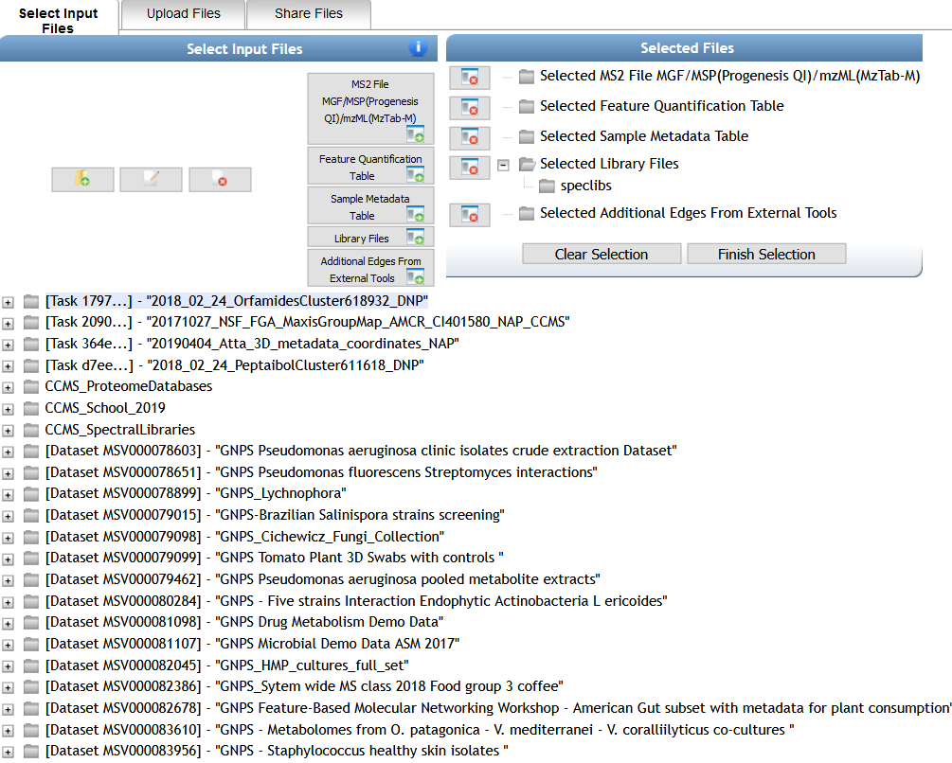
Now you can find the input files

Slide 11
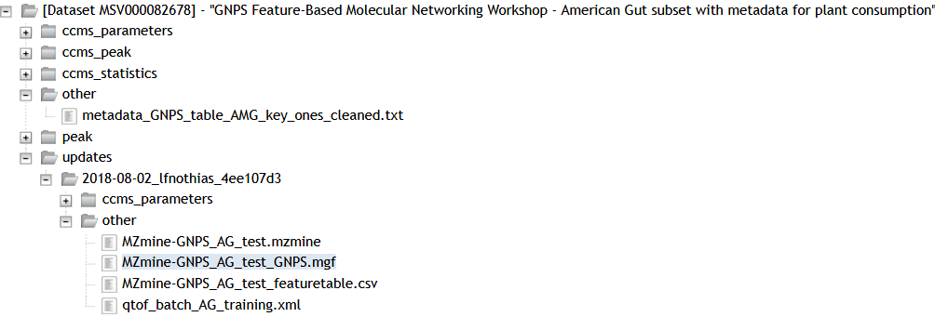
MS2 MGF File
Select it with a click

Slide 12
MS2 MGF File

Slide 13
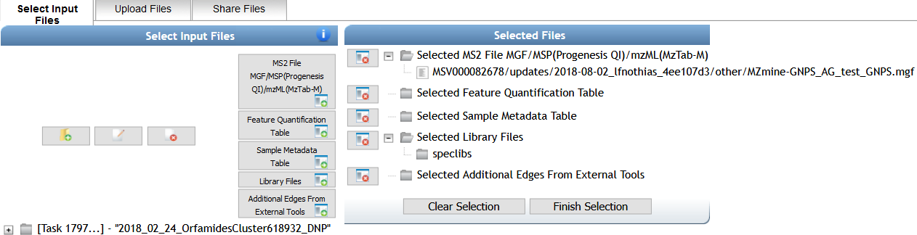
MS2 MGF File

Slide 14
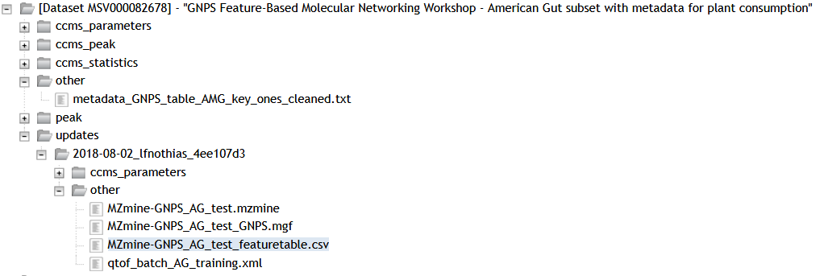
Peak Area
Quantification Table

Slide 15
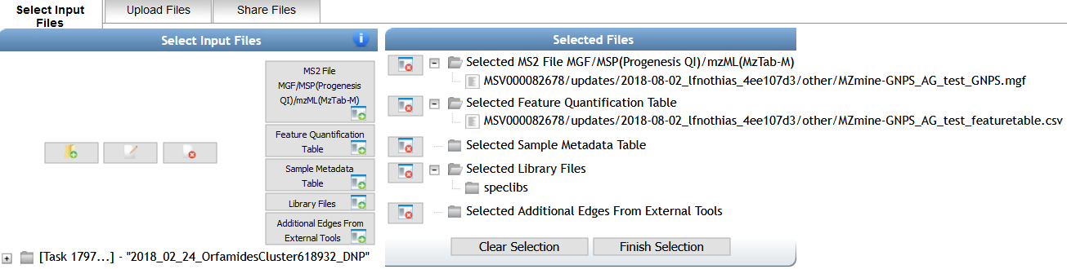
Peak Area
Quantification Table

Slide 16
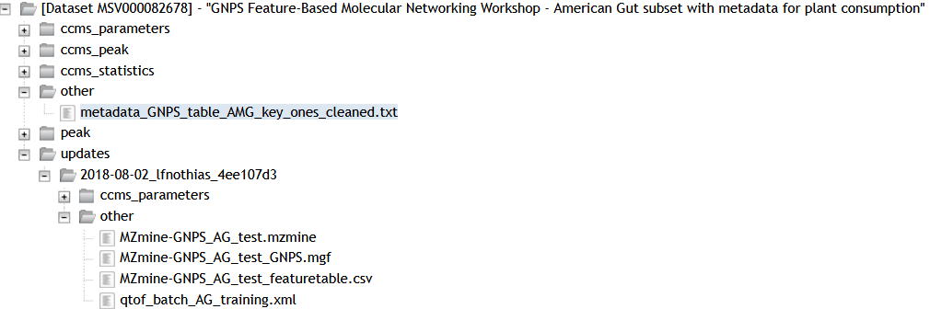
Sample Metadata Table

Slide 17
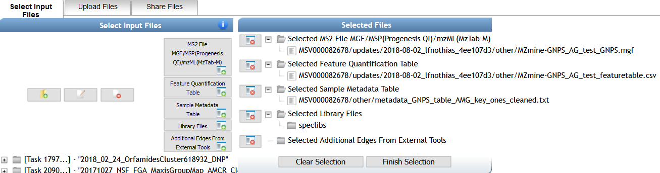
Sample Metadata Table

Slide 18
Finish Selection

Slide 19
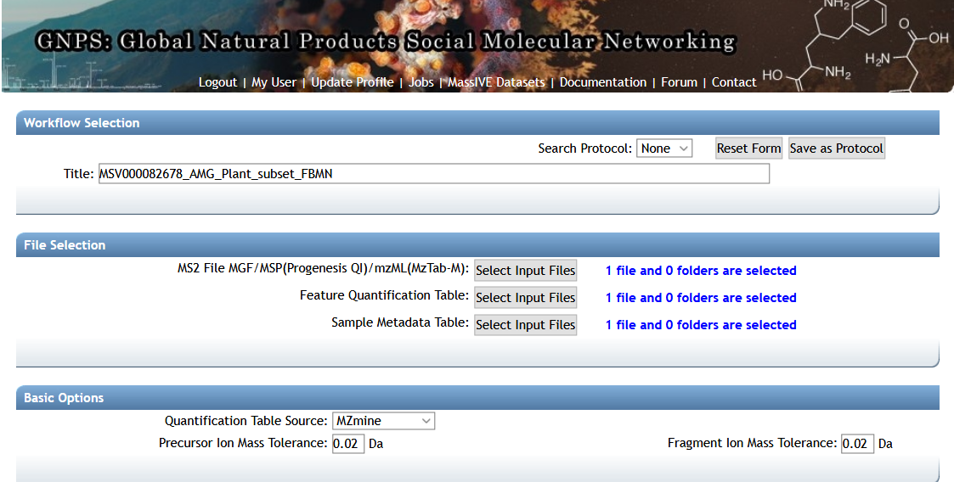
Now you have the selected files

Slide 20
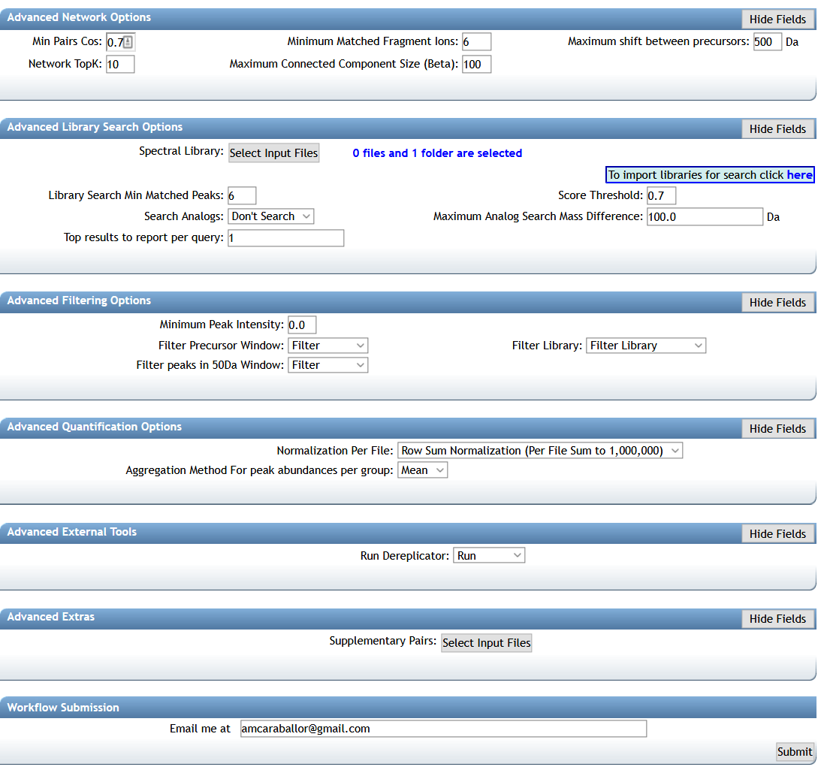
~14 mins
YOUR EMAIL

Slide 21
Questions, Problems or Bugs?
Documentation: https://ccms-ucsd.github.io/GNPSDocumentation/
Forum: https://groups.google.com/forum/#!forum/molecular_networking_bug_reports
PRESENTER’S NAME
E-mail

